Slide 1
EFFECT OF CONVECTION
ON CLIMATE
Name : MD.EMRAN ALAM
ID No : | : | 221-115-110
Batch | : | 56th
Section | : | C
Dept. of Computer Science & Engineering, MU
01

Slide 2
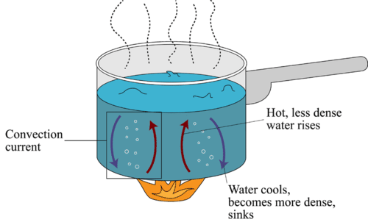
What is convection?
Convection is the movement within a liquid or gas driven by differences in temperature.
Why does convection occur?
Without convection simple tasks such as boiling water in a kettle would be much slower as only the water directly in contact with the heat ring at the bottom of the kettle would be able to be heated, with the water at the top staying cool.
02

Slide 3
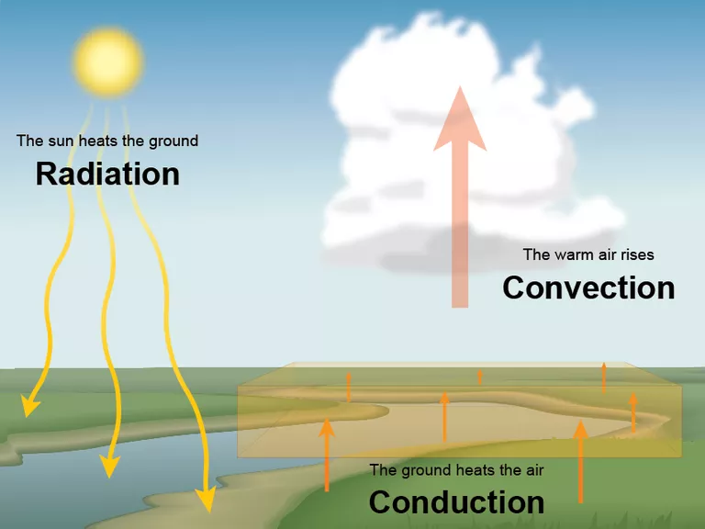
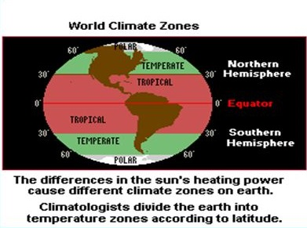
Warm air near earth's surface rises and then cools as it goes up, a convection current is set up in the atmosphere.
Three Atmospheric convection areas (Climate Zones)
The Tropical Region
The Temperate Region
The Polar Region
03

